Slide 1
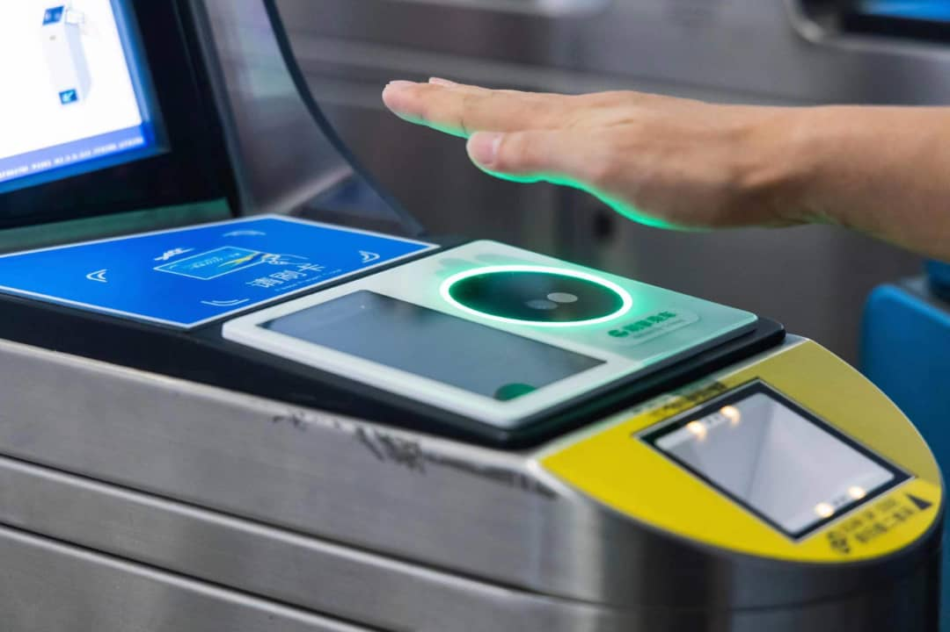
IHUTE:🚀
Introduction to the Future of Palm Payment
Objective:
Develop a PL/SQL-based ticketing and payment system integrating palm biometric authentication for seamless, secure transactions.
Eliminate the need for physical tickets, cash, or mobile scanning, improving security and user experience.
Utilize Oracle PL/SQL to ensure secure transactions, automate workflows, and manage real-time authentication.
Enhance fraud prevention, entry efficiency, and real-time access management at large-scale venues.

Slide 2
Problem Statement & Context
❓
Problem Definition:
Context & Target Users:
Traditional ticketing and payment systems (e.g., paper tickets, cash payments, and mobile scans) are prone to fraud, theft, and counterfeiting.
Manual validation of tickets and payments leads to long queues and delays at entry points in busy venues
Ticket fraud and unauthorized access are constant issues, especially in large events with high foot traffic.
Where Used? 🏟️Stadiums, 🎶🎤 concert halls, 🎭 theaters, ✈️ airports, and large public events requiring secure and efficient access control.
Event Organizers: Improved security, reduced fraud, enhanced user experience, and streamlined entry.
Security Personnel: Reduced workload with automated biometric verification, leading to faster and more secure entry.
Attendees: Enjoy quick, contactless access and payments, eliminating the need for physical tickets or cash transactions.
Merchants: Simplified transaction processes with fraud-free palm payment technology.
Who Benefits?

Slide 3
Database Entities & Benefits
Anticipated Benefits:
Main Entities in the Database: 📂
🛡️ Enhanced Security: Eliminates ticket fraud, counterfeiting, and unauthorized entry.
⚡ Faster Access: Reduces queues by enabling quick biometric-based entry.
🔓 Seamless User Experience: Eliminates the need for paper or mobile-based tickets.
🗄️ Efficient Data Management: Secure database-driven system for real-time tracking and reporting.
Users Table – Stores user details and palm print references
Payments Table – Records transactions and ticket purchases.
Events Table – Manages event details and venue access.
Access Logs Table – Tracks user check-ins and security verifications.

